Slide 1

CS 533 INTRO TO DATA SCIENCE
Michael Ekstrand

Slide 2
UNICODE AND ENCODINGS

Slide 3
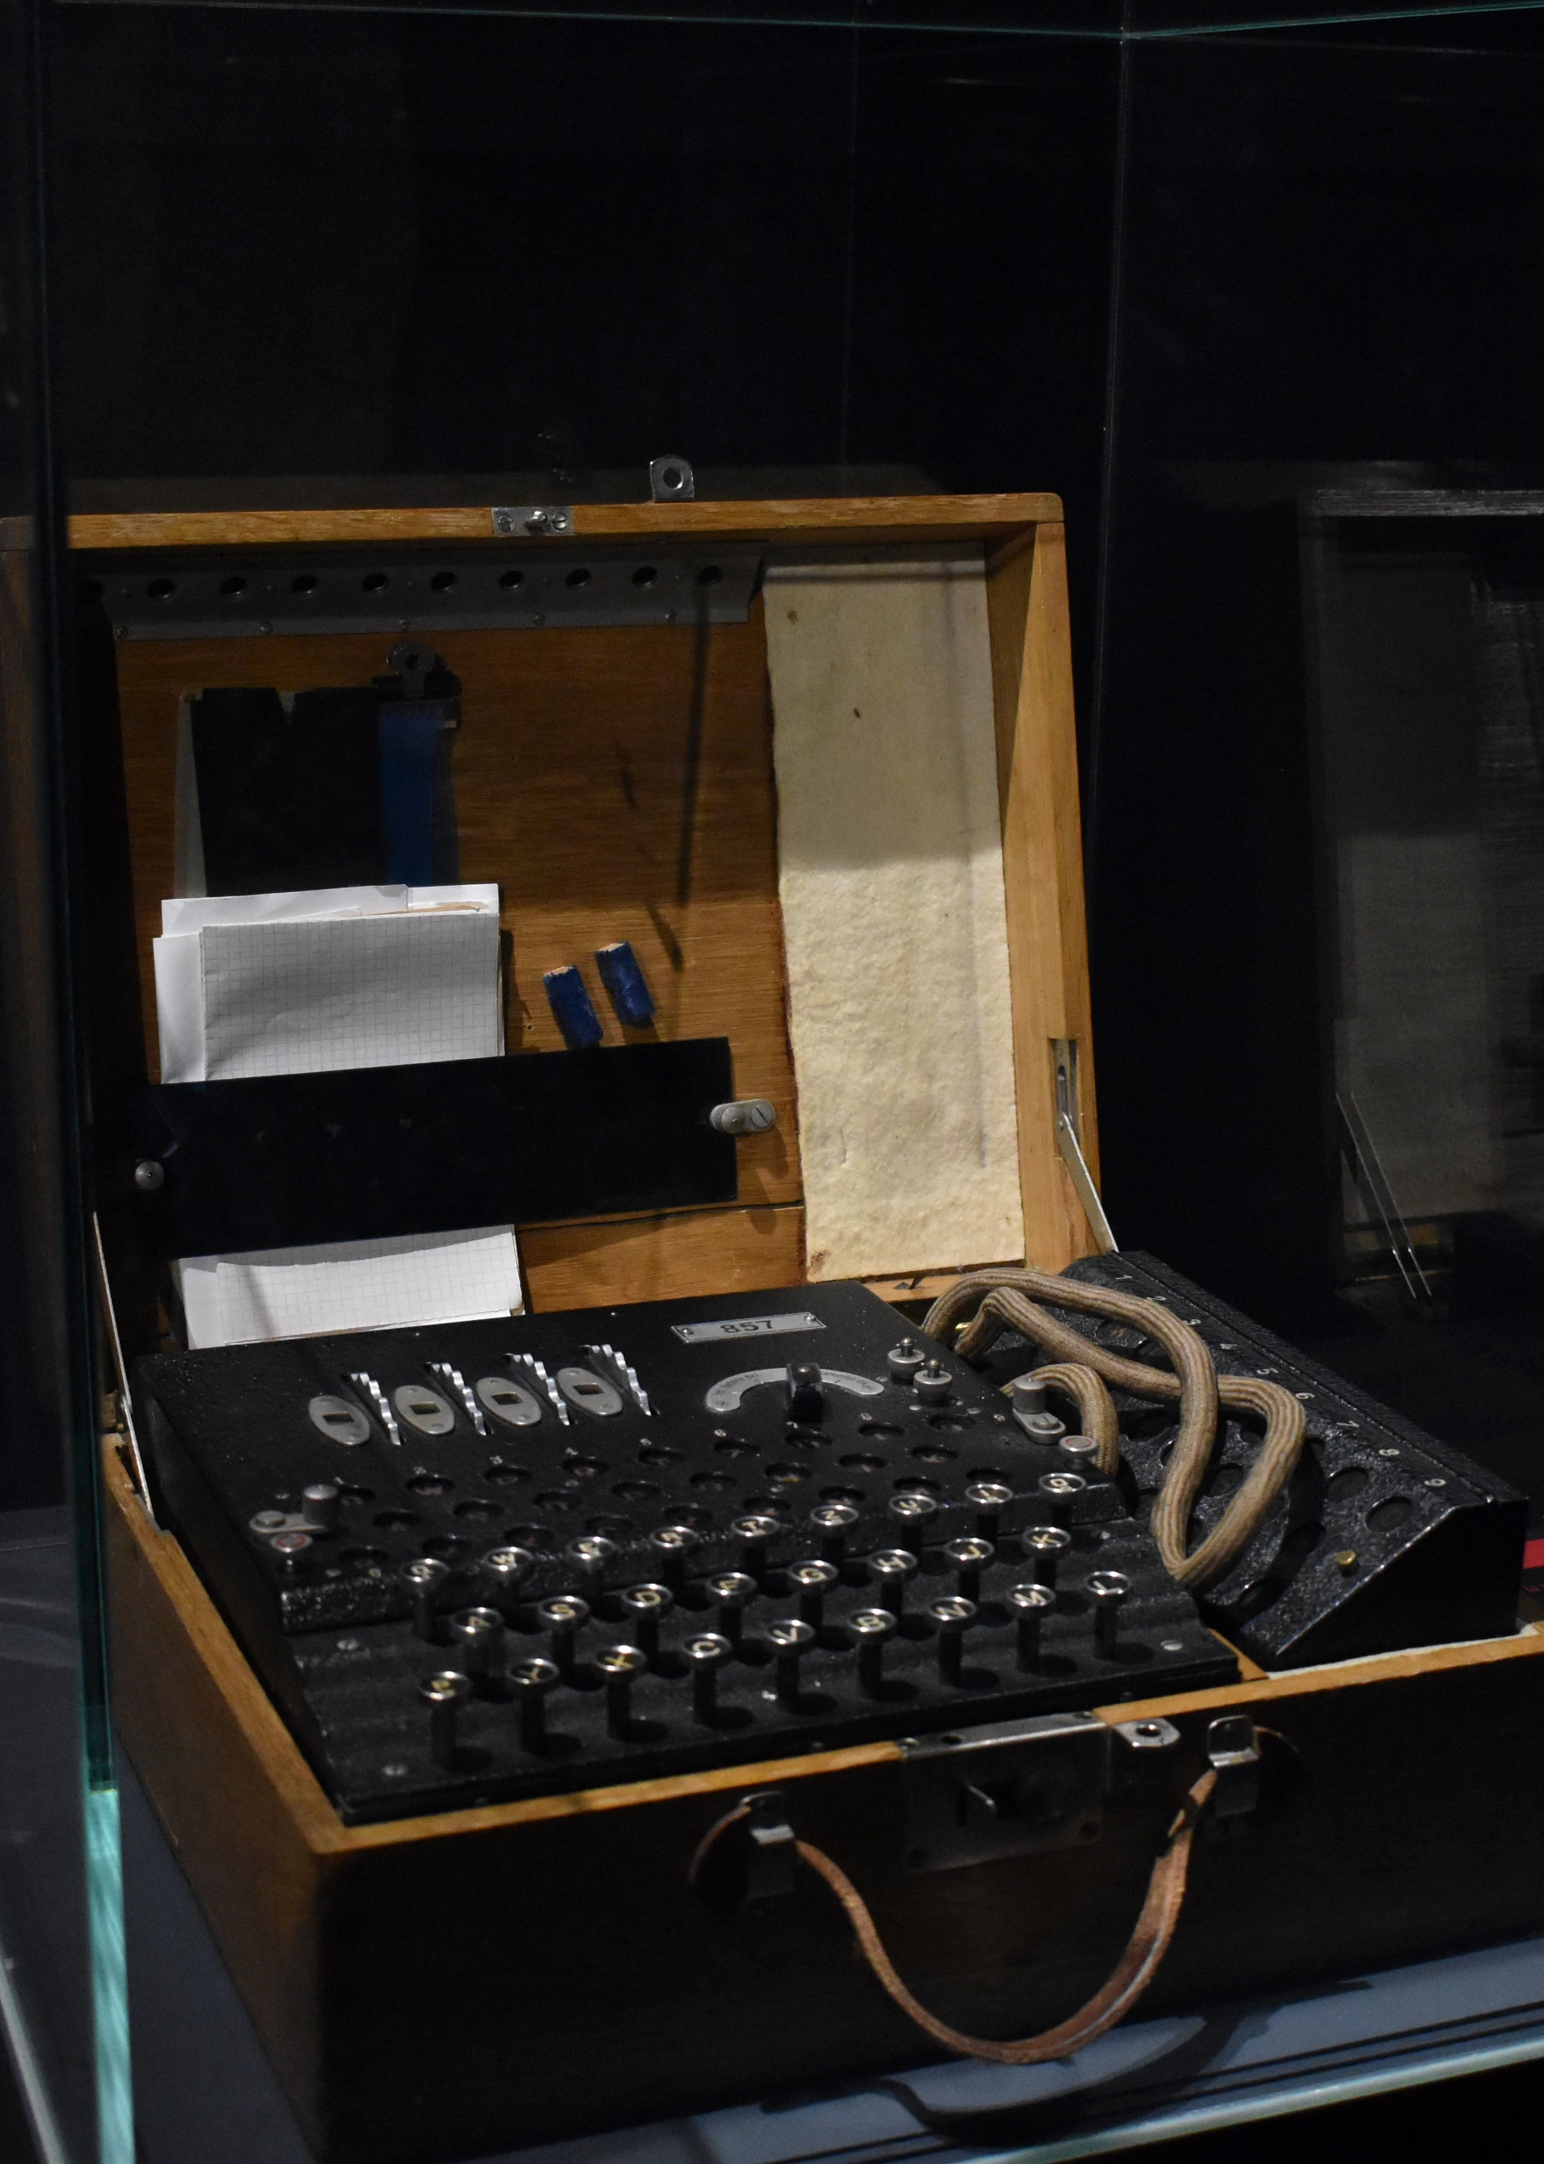
Learning Outcomes
Understand how text is stored in memory and files
Encode and decode text for storage and communication
Distinguish between characters, code points, and bytes
Photo by Mauro Sbicego on Unsplash

Slide 4
Text
Input:
Someone must have slandered Josef K., for one morning, without having done anything truly wrong, he was arrested.
What is this?
A sentence in the English language (the first of the English translation of The Trial by Franz Kafka)
A sequence of characters
A sequence of bytes encoding those characters

Slide 5
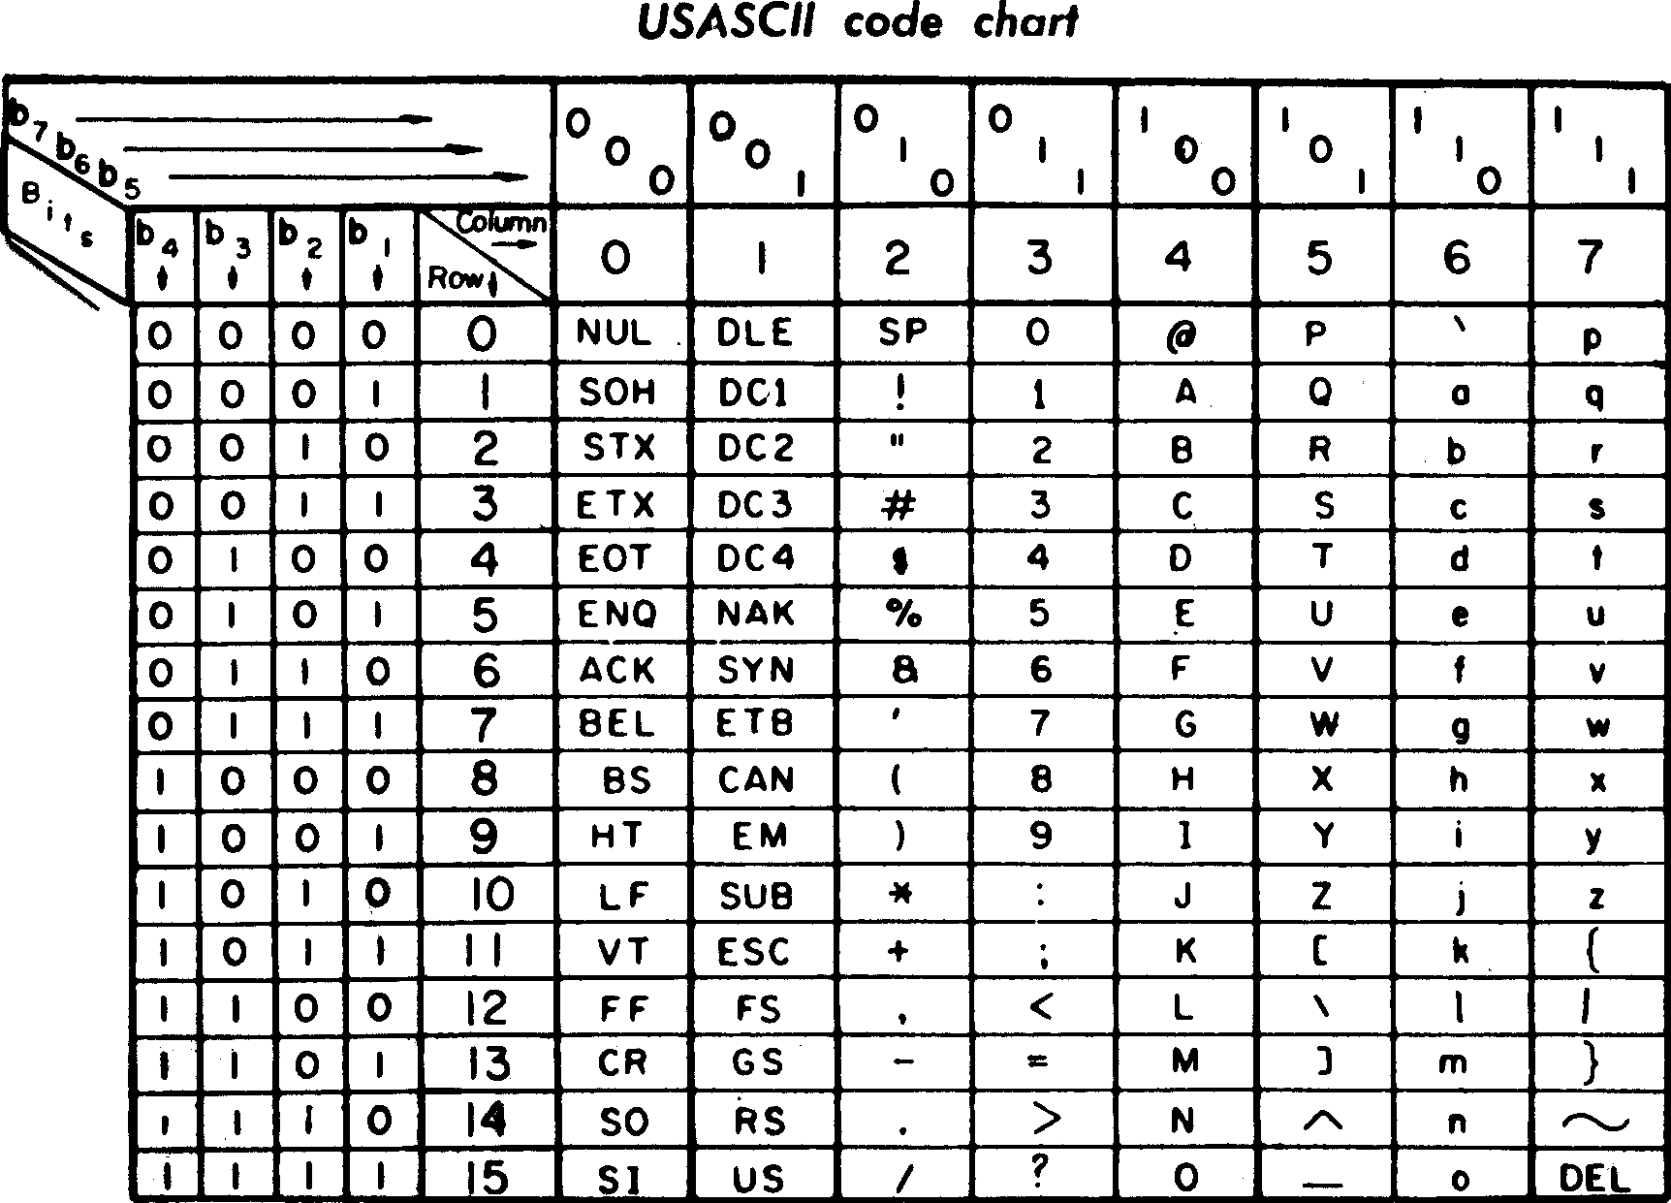
ASCII
American Standard Code for Information Interchange
English letters, symbols, control codes
Represented in 7 bits
Numbers: 48–57
Uppercase: 65–90
Lowercase: 97–122

Slide 6
Beyond ASCII
Encoding only English is naïve
Latin and Cyrillic alphabets: extended code pages
Latin-1: 0–127 ASCII, 128–255 western European accents
Latin-15: 0–127 ASCII, 128–255 eastern European accents
Windows-1252: both (latin-1 with eastern EU in reserved space)
KOI8-R: 0–127 ASCII, 128–255 Russian Cyrillic characters
Ideograph languages: multi-byte character sets (e.g. Big5, GB2312)
Must know encoding.
Very hard to mix encodings and therefore languages (e.g. Turkish and Chinese)

Slide 7
Unicode
International standard for text representation
Text is a sequence of code points
It is encoded into bytes
Universal encodings can encode all valid Unicode
UTF-8, UTF-16, UCS-4
Historic encodings defined as translations for a subset of Unicode
Decode KOI8-R to Unicode code points
Encode to Windows-1252 (may fail!)

Slide 8
Unicode Coverage
Goal: all non-fictional written human language
Includes ancient scripts like Phoenician
Includes math symbols, IPA, emoji, etc.
Does not include fictional languages (Klingon, Elvish, etc)

Slide 9

Python String Types
Python has two string types:
str is a text string, a sequence of code points
s[7] returns the 8th code point in the string
bytes is a byte string, a sequence of 8-bit bytes
bs[7] returns the 8th byte in the string
Convert with:
str.encode() → bytes
bytes.decode() → str

Slide 10

Pandas String Types
Historically: ‘object’ storing Python strings
Either bytes or str
Still the default
Now: ‘string’ type
Get with .astype('string')
Or ‘string’ dtype while loading file
Both support string methods as .str.method()

Slide 11
Encoding and Decoding
Python objects: bytes.decode() / str.encode()
Pandas series: .str.decode() / .str.encode()

Slide 12

Code Points and Characters
Char | J | o | s | e | f |  | K | .
CP (hex) | 4A | 6F | 73 | 65 | 66 | 20 | 4B | 2E
Char | M | ö | t | l | e | y |  | C | r | ü | e
CP | 4D | F6 | 74 | 6C | 65 | 79 | 20 | 43 | 72 | FC | 65
Each character is a code point (often written U+004A)
Characters in LATIN-1 use their Extended ASCII numbers

Slide 13

Combining Characters
Char | M | ö | t | l | e | y |  | C | r | ü | e
CP | 4D | F6 | 74 | 6C | 65 | 79 | 20 | 43 | 72 | FC | 65
Char | M | ö |  | t | l | e | y |  | C | r | ü |  | e
CP | 4D | 6F | 308 | 74 | 6C | 65 | 79 | 20 | 43 | 72 | 75 | 308 | 65
Combining characters modify the preceding character
Add an accent
Modify shape
Assemble complex emoji

Slide 14

Complex Emoji
woman running: dark skin tone
U+1F3C3 — runner
U+1F3FF — skin tone dark
U+200D — zero-width joiner
U+2640 — female
U+FE0F — display as emoji

Slide 15
Code Points ≠ Characters
A character can require multiple code points
len(string) is # of code points, not # of characters
So it won’t tell you how wide it is when printed
A character can be encoded multiple ways
‘ö’ is either U+00F6 or U+006F U+0308 (‘o’ + combining diaresis)
U+2160 is ROMAN NUMERAL ONE, indistinguishable from U+0049 (LATIN CAPITAL LETTER I)

Slide 16
Code Point Data
Unicode database tracks many properties of code points:
Type (letter, number, punctuation, space, etc.)
Case
Many more properties…
Code points divided into blocks
Python unicodedata module provides access

Slide 17
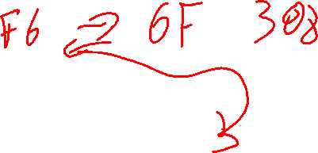
Normalization
Unicode defines normal forms:
NFD (decomposed): always use combining characters
NFC (composed): use single code points whenever possible
NFK[DC]: NFD/NFC with “compatibility characters” replaced
Roman Numeral One turns into Latin Capital I
Non-normalized strings may not be =

Slide 18
Normalization Methods
Python: unicodedata.normalize(form, string)
'Mötley Crüe'.normalize('NFD’)
Length may change
Pandas: .str.normalize(form)

Slide 19
Unicode Subtleties
str.lower() converts string to lower-case
str.casefold() eliminates case distinctions
E.g. ‘ß’ becomes ‘ss’
Many rules locale-specific (e.g. sort order)
locale.strcoll (compare two strings using locale rules)
locale.strxform (convert strings into comparable strings)

Slide 20
Universal Encodings
UTF-8: code points take 1–4 bytes
ASCII is valid UTF-8
UTF-16: 2 bytes per basic character
Characters outside Basic Multilingual Plane (BMP) use 4 bytes
Two-point “surrogate”
Requires byte order
UCS-4: 4 bytes per character, also requires byte order

Slide 21
Python Internal Representation
Stores strings with one of:
Latin-1 (one byte per character)
UCS-2 (two bytes per character, only BMP)
UCS-4
Uses most compact representation that can store the string
len(s) returns the number of code points

Slide 22
Other Internal Representations
Many systems use UTF-16
Java
JavaScript
Windows & Mac APIs
But: often treat it as UCS-2
Java/JS charAt(i) returns UTF-16 code unit
length is 2-byte pairs

Slide 23
First Steps of Processing
Decode the text to convert bytes into text
Normalize the text to render into consistent form
Unicode normal form
Optionally: strip accents (will lose meaning!)
Optionally: casefold

Slide 24
Points to Remember
Always need to know what our encoding is
Decode bytes to get a text string (seq. of code points)
Code points do not map 1:1 with characters
Length of string does not mean printed # of characters
Normalization makes strings comparable
Casefolding makes strings comparable case-insensitively
Sorting is locale-specific
If you have single-byte text that’s not UTF-8, Latin-1 is common

Slide 25

Wrapping Up
“String” is not a simple data type.
Text is encoded both for on-disk storage and in-memory processing.
Photo by Marcel Kovačič on Unsplash

